Slide 1
Digital Portfolio
STUDENT NAME: DHILIPKUMAR I
REGISTER NO : 20324U48005 NMID : A9DB5D377510DC3BCCA417912D4BE7A1
DEPARTMENT: B,SC., (DATA SCIENCE)
COLLEGE: DR.M.G.R. CHOCKALINGAM ARTS COLLEGE/THIRUVALLUVAR UNIVERSITY.

Slide 2
PROJECT TITLE Digital Portfolio – A Responsive and Interactive Personal Portfolio Website.

Slide 3


AGENDA
Problem Statement
Project Overview
Who Are The End Users?
Tools And Techniques
Portfolio Design And Layout
Features And Functionality
Results And Screenshots
Conclusion
Githup link
3/21/2024 Annual Review

Slide 4

PROBLEM STATEMENT
• Traditional resumes are static and provide limited space to demonstrate practical skills and project work.
• Recruiters often need quick, interactive evidence of an applicant's capabilities, which plain text resumes fail to supply.
• A digital portfolio addresses these gaps by offering an engaging, visual, and organized presentation of work and skills.

Slide 5

PROJECT OVERVIEW
• Built a responsive personal portfolio website using HTML, CSS, and JavaScript to showcase skills, projects, and contact information.
• The site includes sections for Home, About, Skills, Projects, and Contact and is optimized for desktop and mobile viewing.
• The portfolio emphasizes usability, fast load times, and a clean visual design to strengthen personal branding.

Slide 6

WHO ARE THE END USERS?
• Students seeking internships and academic opportunities.
• Job seekers applying for front-end or web development roles.
• Freelancers showcasing capabilities to potential clients.
• Recruiters and hiring managers who require quick, visual evaluation of candidates' work.

Slide 7

TOOLS AND TECHNIQUES
• Languages: HTML for structure, CSS for styling, and JavaScript for interactivity.
• Development: Visual Studio Code for coding and GitHub for version control and hosting demos.
• Design & Assets: Figma or Canva for mockups and design planning; free icon libraries for visuals.

Slide 8
POTFOLIO DESIGN AND LAYOUT
• Clean, minimal header with navigation links to Home, About, Skills, Projects, and Contact sections.
• Hero section that highlights name and role with a call-to-action button to view projects.
• Cards for content sections and a responsive grid so the layout adapts to mobile and tablet screens.
8

Slide 9
FEATURES AND FUNCTIONALITY
• Dark/light theme toggle to improve readability and user preference settings.
• Smooth scrolling navigation and anchor links for quick section jumps.
• Animated skill progress bars that activate on scroll to visually represent expertise levels.
• Project list with links to live demos, GitHub repositories, and short descriptions.

Slide 10

RESULTS
• The website was implemented and tested across multiple devices and screen sizes to ensure responsiveness.
• Screenshots to include: homepage hero, skills section with animated bars, projects gallery, and contact section.
• (Placeholder) Add actual screenshots of the deployed site or local preview images in the presentation.
3/21/2024 Annual Review
10

Slide 11
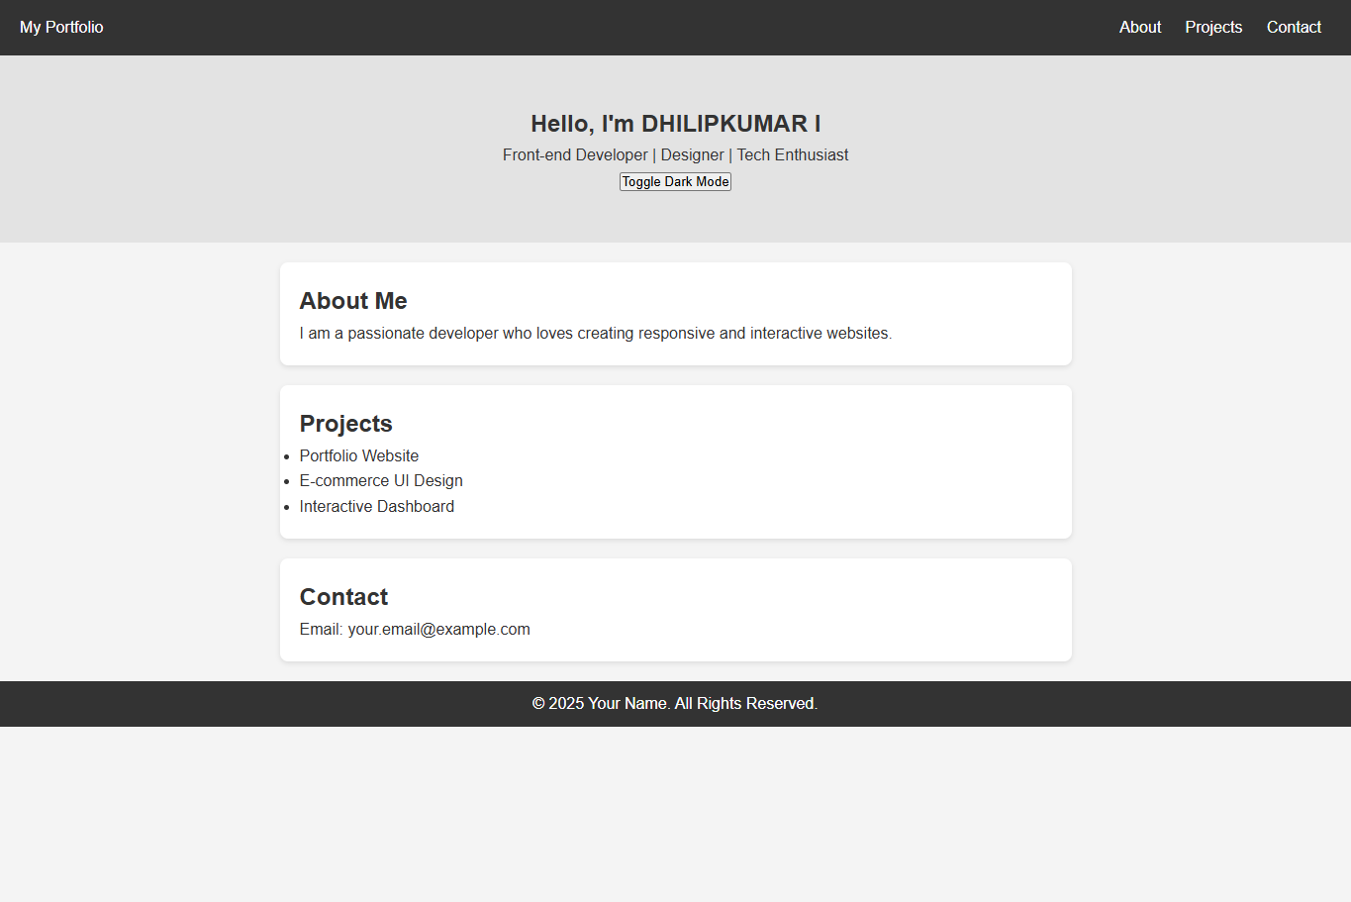
SCREENSHOTS

Slide 12
CONCLUSION
• The digital portfolio effectively showcases practical skills, project experience, and professional contact details in a single, accessible location.
• It enhances visibility with recruiters and clients by providing interactive demonstrations of work and clean, readable presentation.
• Future enhancements may include a blog section, CMS integration for dynamic content, contact form backend, and more sample projects.
12

Slide 13
GITHUP LINK
https://github.com/dhilipkumar20324u48005-design/TNSDC-FWD-Digital-portfolio.git
https://dhilipkumar20324u48005-design.github.io/TNSDC-FWD-Digital-portfolio/

